Slide 1

Unveiling Winning Insights: A Deep Dive into the IPL
Welcome! Let's explore the IPL using a data-driven approach to understand key trends and insights that impact team performance.

Slide 2
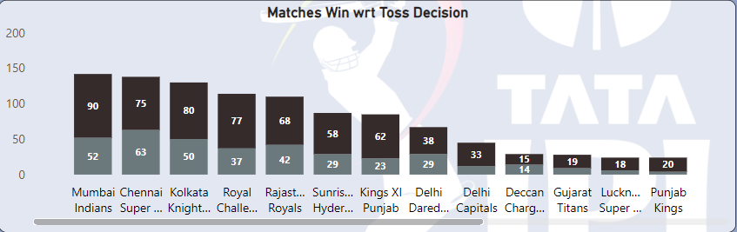

Matches Won: Batting First vs Fielding First
Batting First
Fielding First
Teams that bat first often gain a strategic advantage, securing a target that can be difficult to chase.
Taking wickets early in 2nd inning to put them into the pressure and won matches.
Fielding first allows teams to capitalize on early wickets and restrict the opposition's score, putting them in a dominant position.
Some teams very good in chasing the targets.

Slide 3
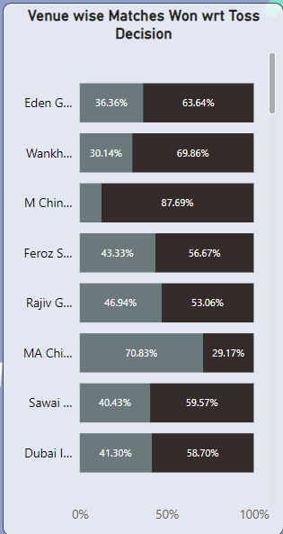
Field
Bat
Venue-wise Matches Won: Toss Decisions
Home Advantage
Teams often perform better at their home venues, benefiting from familiar conditions and fan support.
Toss Impact
The toss decision can heavily influence match outcomes, as teams choose to bat or field first based on pitch conditions.

Slide 4
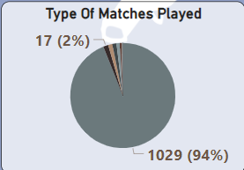
Types of Matches Played
League Matches
Regular season matches determine team rankings and qualification for playoffs.
1029 (90%) are the league matches out off 1095 total matches.
Playoff Matches
These high-stakes matches decide which teams advance to the final and compete for the championship.
It divide in three steps – (1) Qualifier – 1 = 14
(2) Qualifier – 2 = 14
(3) Eliminator = 11
Final Match
The ultimate showdown, where the two best teams face off for the coveted IPL trophy.
17 (2%) are the Final Matches out of 1095.

Slide 5
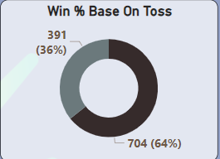
Win Percentage Based on Toss Outcome
Field
Winning the Toss
Bat
Winning the toss provides teams with a significant advantage, allowing them to choose their preferred batting or fielding according to conditions.
Losing the Toss
Teams that lose the toss must adapt to the opponent's strategic choices, making it harder to win.

Slide 6

Number of Titles Won
Champion Teams
CSK
Deccan
KKR
Certain teams have established themselves as IPL powerhouses, consistently winning titles and showcasing their dominance.
GT
IPL History
MI
SRH
The IPL has witnessed numerous title wins, revealing the evolving dynamics and competitive landscape of the tournament.
RR

Slide 7
Key Trends in IPL Match Outcomes
Home Advantage
Toss Impact
Chasing Targets
Teams performing better at home due to familiar conditions and fan support.
The toss decision heavily influences match outcomes, shaping team strategies and advantages.
Teams chasing targets often have a slight advantage, as they can adapt their strategies based on the opponent's score.

Slide 8

Factors Influencing Team Performance
Player Skill
Team Chemistry
The individual skill and experience of players play a crucial role in determining team performance.
Strong team cohesion and understanding between players create a powerful synergy that boosts performance.
Strategic Decision Making
Effective captaincy and coaching decisions influence team strategies and ultimately impact the outcome.

Slide 9




Insights for Improving Team Strategies
Data-Driven Approach
Utilizing analytics and data to understand team strengths, weaknesses, and opponent tendencies.
Player Development
Investing in player development programs to enhance skills and improve individual performance.
Strategic Adaptability
Adapting strategies based on pitch conditions, opponent strengths, and the ever-changing dynamics of the game.

Slide 10

Conclusion and Recommendations
The IPL is a dynamic and unpredictable tournament where a multitude of factors influence match outcomes. Teams must focus on data-driven insights, player development, and strategic adaptability to achieve success.

Slide 11
